Slide 1
Activity 04: Evaluation
SISMID Lab
July 22 through July 24, 2026
A Human – AI Teaming Approach to Infectious Disease Modeling

Slide 2
Lecture Overview
Topic | Slides
1. General Housekeeping | 3
2. Lab Timeline | 4
3. Task Overviews | 5
4. Goal Output | 6
5. Evaluation Metrics | 7–14
6. Scoring with scoringutils | 15–18
7. Set-Up and Overview | 19–20
8. Task 1: Input Data | 21–23
9. Task 2: Scoring the Forecast | 24–27
10. Task 3: Output Table | 28–30
11. Task 4: Summary by Horizon | 31–33

Slide 3

General Housekeeping
Any slide with this icon contains the overview and
expected outputs for the included tasks. All outputs listed on these slides should be uploaded to the course GitHub repository for review.
Any slide with this icon indicates that it is time to complete a hands-on activity. Carefully follow the instructions provided, complete the required task, and verify your results.

Slide 4
Lab Timeline
We are here
Activity 1
Activity 2
Activity 3
Activity 4
Data Cleaning &
Visuals
Data
Exploration
Modeling & Forecasting
Evaluation
Activity 5 Refinement

Slide 5
Task Overviews
Task | Description
Task 0: Set-Up | Add the section headers and file paths and set a global rule telling the AI to use the scoringutils package for the entire pipeline and not to hand-code the scoring formulas.
Task 1: Input Data | Load the FluSight forecast file and the cleaned observed data, join them on a common key (target_end_date and week), and drop the targets that have no observed value to score against.
Task 2: Scoring the Forecast | Rename the joined columns to the scoringutils conventions and add a model label, build the forecast object with as_forecast_quantile(), score it, and extract WIS, AE, and 95% PI coverage.
Task 3: Output Table | Format the first output table, one row per reference date and horizon, sorted ascending and rounded to one decimal, then print it and save it to output/data/04_evaluation/.
Task 4: Summary by Horizon | Average the per-forecast scores across reference dates within each horizon to show how forecast skill changes with lead time, then print and save the second table.

Slide 6
Goal Output
From the activity (see previous slide), you should produce two scored output tables. Guided by the rules you write, an AI agent scores your Activity 3 forecasts against the cleaned admissions data using the scoringutils package, and saves the results through scripts/04_evaluation.R.
Activity Output | Description
forecast_scores.csv | Per-forecast scores, one row per reference date and horizon, with columns for reference_date, horizon, target_end_date, observed, WIS, AE, and coverage_95.
forecast_scores_by_horizon.csv | Summary scores by horizon, with n plus the mean WIS, MAE, and 95% coverage and the minimum and maximum of WIS and MAE, showing how forecast skill decays with lead time.

Slide 7
Evaluation Metrics

Slide 8
Overview
We are going to focus on calculating some of the primary metrics used by the FluSight challenge, and commonly throughout forecast evaluation
This includes, but is not limited to, mean absolute error (MAE), 95% prediction interval (PI) coverage, and weighted interval score (WIS)
Note that the metrics come with their own strengths and weaknesses, and represent only a minuscule portion of the evaluation approaches available

Slide 9
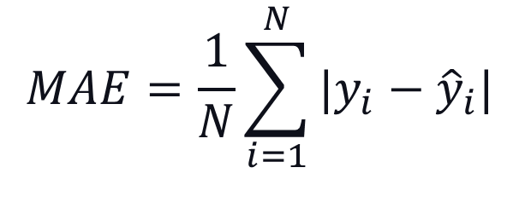
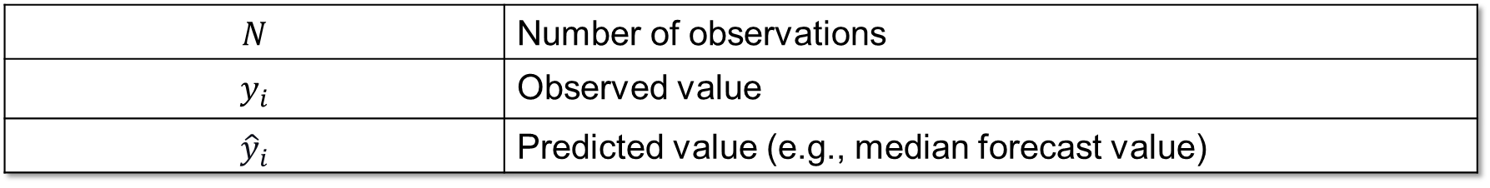
Mean Absolute Error (MAE)
Measure of how accurate point (single value per time point) forecasts are (i.e., how far the model's predictions fall from the observed admission counts).
$$MAE=\frac{1}{N}\sum_{i=1}^{N}{|y_{i}−{\hat{y}}_{i}|}$$
$$N$$ | Number of observations
$$y_{i}$$ | Observed value
$${\hat{y}}_{i}$$ | Predicted value (e.g., median forecast value)
Ideal Value: Lower is better!

Slide 10
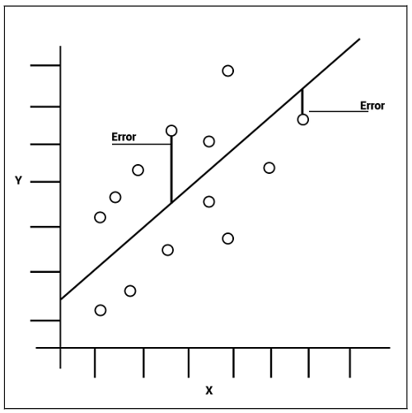

Slide 11
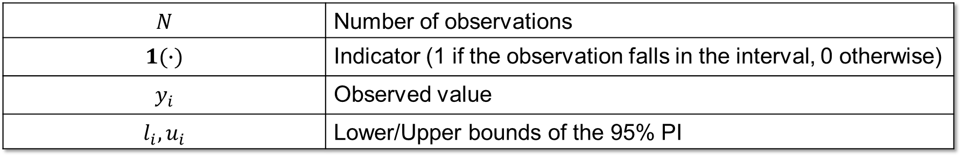
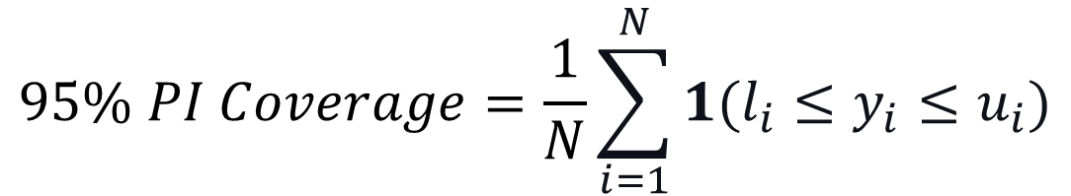
95% Prediction Interval (PI) Coverage
Measures how often the observed value is captured within the bounds of the 95% prediction interval (i.e., measure of how well the model captures uncertainty).
$$95\% PI Coverage=\frac{1}{N}\sum_{i=1}^{N}{1(l_{i}≤y_{i}≤u_{i})}$$
$$N$$ | Number of observations
$$1(∙)$$ | Indicator (1 if the observation falls in the interval, 0 otherwise)
$$y_{i}$$ | Observed value
$$l_{i}, u_{i}$$ | Lower/Upper bounds of the 95% PI
Ideal Value: ~95%; Below 95% = intervals too narrow (overconfident); above 95% = too wide (underconfident).

Slide 12
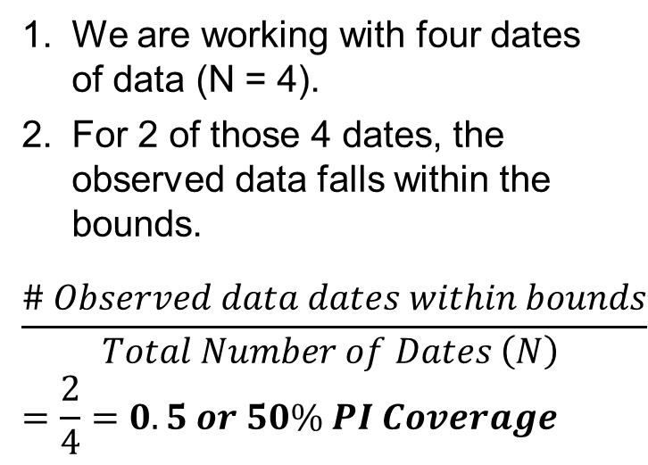
Legend
 | Observed Data
 | Forecasted Median
 | 95% PI Bounds
Calculating the 95% PI Coverage
We are working with four dates of data (N = 4).
For 2 of those 4 dates, the observed data falls within the bounds.
$$\frac{\# Observed data dates within bounds}{Total Number of Dates \left(N\right) }=\frac{2}{4}=0.5 or 50\% PI Coverage$$
Total Influenza Admissions
Weeks
50% is far below the nominal 95%, so these intervals are too narrow — the model is overconfident.

Slide 13
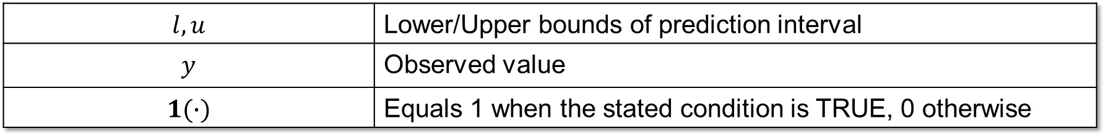
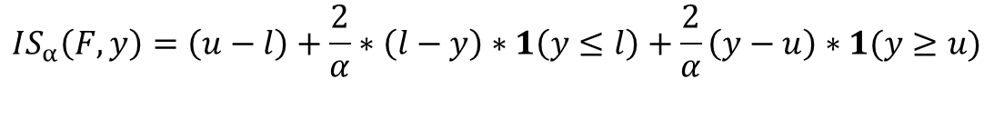
Interval Score (IS)
Measures how well a single prediction interval performs, rewarding intervals that are narrow but penalizing ones that the observed value falls outside, in the units of the observed data.
Overprediction
$$IS_{α}\left(F,y\right)=\left(u−l\right)+\frac{2}{α}∗\left(l−y\right)∗1\left(y≤l\right)+\frac{2}{α}\left(y−u\right)∗1(y≥u)$$
Dispersion
Underprediction
$$l, u$$ | Lower/Upper bounds of prediction interval
$$y$$ | Observed value
$$1(∙)$$ | Equals 1 when the stated condition is TRUE, 0 otherwise
Ideal Value: Lower is better!
Notes:
https://epiforecasts.io/scoringutils/articles/scoring-rules.html?q=interval%20scores#weighted-interval-score-wis

Slide 14
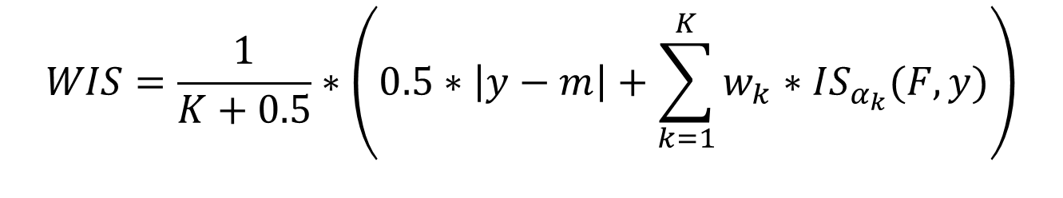
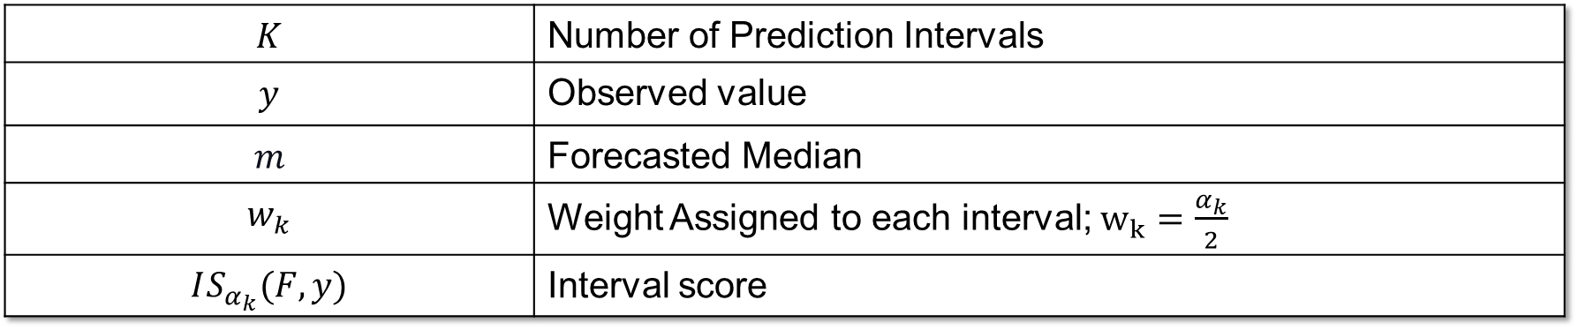
Weighted Interval Score (WIS)
Measures overall forecast quality, focusing on how close the whole predicted distribution is to the observed value, in the units of the observed data. It rewards forecasts that are both accurate and appropriately confident.
$$WIS=\frac{1}{K+0.5}∗\left(0.5∗\left|y−m\right|+\sum_{k=1}^{K}{w_{k}∗IS_{α_{k}}(F,y)}\right)$$
$$K$$ | Number of Prediction Intervals
$$y$$ | Observed value
$$m$$ | Forecasted Median
$$w_{k}$$ | Weight Assigned to each interval; $w_{k}=\frac{α_{k}}{2}$
$$IS_{α_{k}}(F,y)$$ | Interval score
Ideal Value: Lower is better!

Slide 15
scoringutils Package
What should we use to calculate the metrics?

Slide 16
From Formulas to Code
scoringutils is an R package that provides multiple built-in metrics and proper scoring rules to simplify the process of evaluating probabilistic forecasts against true observed values.
It’s easy to implement (three steps):
We will work through each step together (and with AI) to evaluate our ARIMA models from the last activity.
Prepare the Forecasts
‘Score’ the Forecasts
Summarize the Results

Slide 17
Required Data Format
It expects at least observed, predicted, and quantile_level columns. However, it can take ‘grouping’ variables as well (e.g., location, horizon) that can be used to group and summarize scores.
Our current set-up maps to the package requirements as follows:
Required Package Format | In Hubverse terms | Description
forecast_unit | location, reference_date, horizon, target_end_date, model | The columns that uniquely identify one forecast; also used for later summarization.
observed | cleaned_flu_admissions.csv | The observed truth; we will join the truth data with the forecast file.
predicted | value | The forecasted value.
quantile_level | output_type_id | The quantile the value corresponds to (0 to 1).

Slide 18
Implementation

Slide 19
Overview
Rather than hand-coding the evaluation, we'll write rules in rules.md that an AI uses to build the script (04_evaluation.R), covering the whole pipeline, from preparing the data to writing the output tables.
Our end goal is two tables: one with forecast-by-forecast performance (Rule 3), and one with summary metrics by horizon (Rule 4).
Rule 1
Input Preparation
Rule 2
Scoring with scoringutils
Rule 3
Output table
Rule 4
Summary by horizon

Slide 20
Initial Set-Up
Prior to specifying Rules 1 - 4 for evaluating forecasts, we need to do some initial set-up like we have done for other activities (e.g., headers, file paths, etc.).
Given we specifically want to use the scoringutils package for the entire pipeline, we want to make sure this is clear and respected by the AI. Therefore, we are going to add a global rule specifying this.
# Forecast Evaluation
Save all code in this section to `output/scripts/04_evaluation.R`. If the folder path is not present, create it before saving the script.
Use the **scoringutils** package to compute the metrics — do not hand-code the scoring formulas.

Slide 21
Loading the Data (## 1. Input Data)
We need to be explicit about what files we want to include as part of the evaluation.
scoringutils requires both forecasts and observed data in a single data frame; we need to load the files prior to merging them.
File Type | Forecasts | Observed Truth
File Path | output/data/03_forecast/flusight_forecasts.csv | output/data/01_cleaning/cleaned_flu_admissions.csv
File Format | reference_date, target, horizon, target_end_date, location, output_type, output_type_id, value | week, location, value

Slide 22
Joining Forecasts & Truth Data
We now need to join each forecast row to the observed truth by matching on a common variable (Hint: It’s target_end_date & week).
Only forecasts with a matching observed value can be scored. The 2- and 3-week-ahead targets that fall beyond the last observed week have no truth to compare against, so we drop them.
Including a message of how many combinations were dropped for lack of an observed target will act as a check in the code (i.e., is it functioning as it should).

Slide 23
Now it’s your turn!
On your own, use the previous two slides to specify rules to load the proper data files and merge them on a common key (Hint: target_end_date & week)
1
Create the ## 1. Input Data section header under the initial set-up code in rules.md.
Write detailed rules to load the two needed files (Hint: provide the file paths for the forecasts & observed data), merge them on a common key, and drop targets with no observed value.
2
3
Regenerate agents.md from your updated rules document.
4
Use the agents.md file and Copilot (or your preferred AI) to generate scripts/04_evaluation.R. Run the script and check the output.

Slide 24
Shaping the Data (## 2. Scoring with scoringutils)
scoringutils only recognizes its own column names, so before scoring we relabel the joined data to match its conventions.
The FluSight data is already long (one row per quantile), so this is a rename, not a reshape. No pivoting needed; we're relabeling columns, not restructuring rows.
Three renames: output_type_id → quantile_level, value → predicted, and the joined truth value → observed.
Add a constant model column (e.g. "arima"). scoringutils is built to compare models, so it expects a model label; with only one model we still include it, since it's part of the forecast unit.

Slide 25
Scoring the Forecast
Prior to scoring the forecast (i.e., evaluating the forecasts), we convert our new data frame to a forecast object (data table with class of forecast).
scoringutils::as_forecast_quantile() creates the forecast object; we specify the forecast unit (what defines a unique forecast). This allows each reference_date × horizon combination to be evaluated as its own forecast.
Forecast unit: reference_date, horizon, target_end_date, location, model
Finally, we call scoringutils::score() on our forecast object.

Slide 26
Extracting the Metrics
scoringutils provides a plethora of metrics. We can provide rules to make sure that the AI extracts (or calculates) only the metrics we want:
As a precaution, we can give back up options (think substitute options) in case a metric cannot be extracted. For example, for 95% PI coverage:
WIS: The wis column returned by score().
AE: the ae_median column (absolute error of the median); averaged across reference dates it becomes MAE (Rule 4).
95% PI coverage: The 95% interval coverage metric.
If score()’s defaults do not already include it, add it via scoringutils' interval-coverage
metric at the 95% range (e.g. supply a custom interval_coverage metric with
the interval range set to 95).

Slide 27
Now it’s your turn!
We will work through the following steps together to add the next section to our rules.md document.
1
Create the ## 2. Scoring with scoringutils section header in rules.md.
Write detailed rules to shape the data, score the forecast, and extract the metrics of interest (e.g., AE, WIS, 95% PI coverage).
2
3
Regenerate agents.md from your updated rules document.
4
Use the agents.md file and Copilot (or your preferred AI) to generate scripts/04_evaluation.R. Run the script and check the output.

Slide 28
## 3. Output Table
Now that we have extracted our metrics, we can begin to prepare the output table(s).
First, we want a table with one row per evaluated reference_date and horizon combination, with columns for reference_date, horizon, target_end_date, observed, WIS, AE, and coverage_95.
Example Table: Sorted ascending by reference_date, then horizon. Metrics rounded to one decimal.
reference_date | horizon | target_end_date | observed | WIS | AE | coverage_95
2025-09-27 | 1 | 2025-10-04 | 976 | 332.2 | 174 | 1
2025-09-27 | 2 | 2025-10-11 | 1016 | 577 | 202 | 1
2025-09-27 | 3 | 2025-10-18 | 1119 | 754 | 99 | 1
File path to save to: `output/data/04_evaluation/forecast_scores.csv` (create the folder if absent).

Slide 29
Now it’s your turn!
On your own, use the previous slides to specify rules to format the first of two output tables (Hint: your only task is to reformat the results we already have).
1
Create the ## 3. Output Table section header under the ## 2. Scoring with scoringutils header in rules.md.
Write detailed rules to create the first output table (Hint: refer to previous slide for format), sort by reference date and then horizon, round the metrics to one decimal, and print & save the table.
2
3
Regenerate agents.md and use it and Copilot (or your preferred AI) to generate scripts/04_evaluation.R. Run the script and check the output.

Slide 30
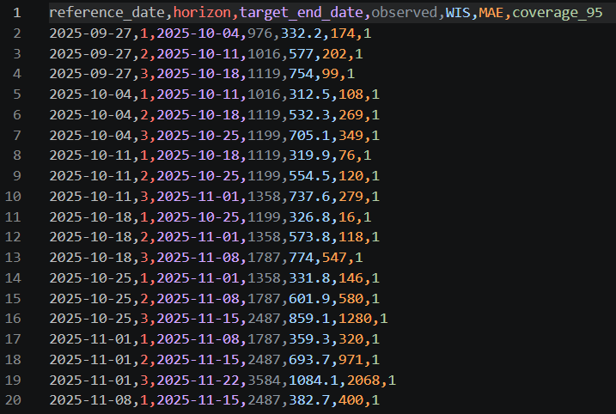
Expected Output

Slide 31
## 4. Summary by Horizon
This is where per-forecast scores become forecast skill. Averaging each horizon's scores across all its reference dates shows how accuracy changes with lead time.
We want one row per horizon: the mean of WIS, MAE, and coverage_95, the min/max of WIS and MAE, and n (# reference dates). The mean of the 0/1 coverage is the empirical 95% coverage rate
Example Table: sorted ascending by horizon. WIS_* and MAE_* rounded to one decimal, coverage_95_mean to two.
horizon | n | WIS_mean | WIS_min | WIS_max | MAE_mean | MAE_min | MAE_max | coverage_95_mean
1 | 34 | 245.8 | 88.4 | 512.6 | 168.3 | 42.0 | 388.0 | 0.92
2 | 34 | 431.5 | 190.2 | 803.1 | 236.7 | 95.0 | 511.0 | 0.82
3 | 34 | 612.9 | 268.7 | 1094.4 | 331.4 | 99.0 | 702.0 | 0.70
File path to save to: `output/data/04_evaluation/forecast_scores_by_horizon.csv` (create the folder if absent).

Slide 32
Now it’s your turn!
On your own, use the previous slides to specify rules to format the second of two output tables (Hint: your only task is to reformat the results we already have).
1
Create the ## 4. Summary by Horizon section header under the ## 3. Output Table header in rules.md.
Write detailed rules to create the second output table (Hint: refer to previous slide for format). Group by horizon, compute the mean of WIS, MAE, and coverage_95 plus the min/max of WIS and MAE, sort ascending by horizon, round WIS/MAE to one decimal and coverage_95_mean to two, then print & save the table.
2
3
Regenerate agents.md and use it and Copilot (or your preferred AI) to generate scripts/04_evaluation.R. Run the script and check the output.

Slide 33

Expected Output

